Slide 1



Name Student: 1-Waad Awad 2-Hamud Alrezq 3 AbeerAbdullah

Slide 2
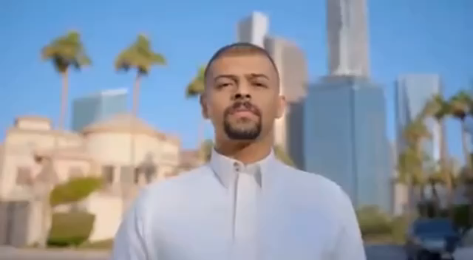

Slide 3
Node.js
system used:
React
Express
Axios
localstorg
bootstrap

Slide 4
Project Ideas:
Blood Bank Project (Wateen)
Log in & Register
Through the website, you can book an appointment to donate blood
You can know all the information about the different blood types
You can know the journey of the blood bag
Knowing the history of blood donation
Knowing the number of registered users on our site and their different blood types
You can contact us through the social networking sites written on the site

Slide 5
Project Requirements:
Being able to navigate and view some information
class-based components (with states and lifecycle methods)
Function-based components with useState , useEffect , useParams , and useNavigate hooks.
CRUD operations

Slide 6
Project contents:
BACK END
(Navbar): Contains a login and search
(main): Contains blood group information and appointment booking
(footer): Means of communication
FRONT END
Data
User
User Router
Server

Slide 7
View site

Slide 8




